Slide 1
Three number sort
2023/03/04

Slide 2
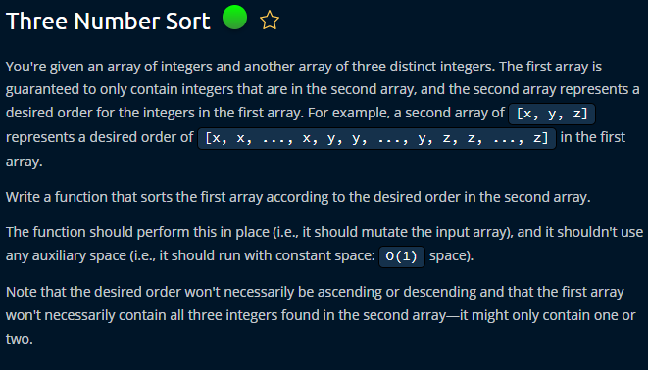

Slide 3
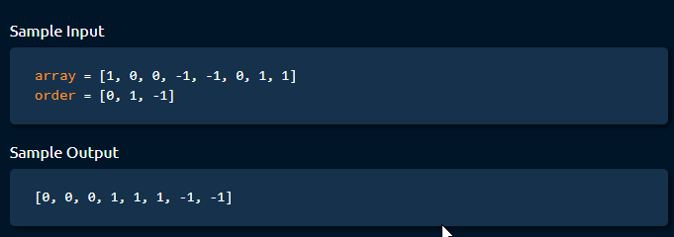

Slide 4
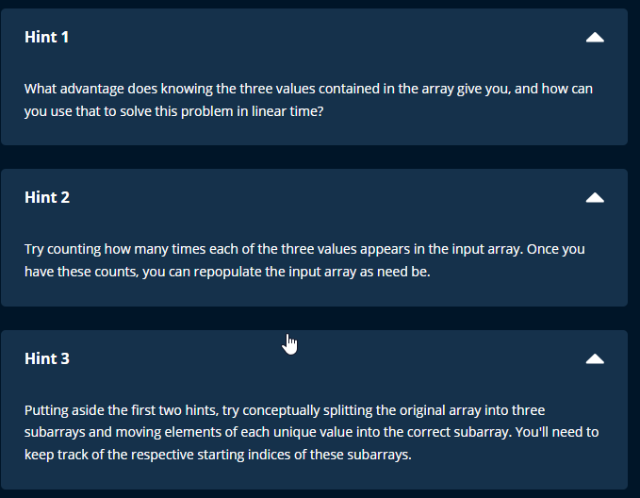

Slide 5
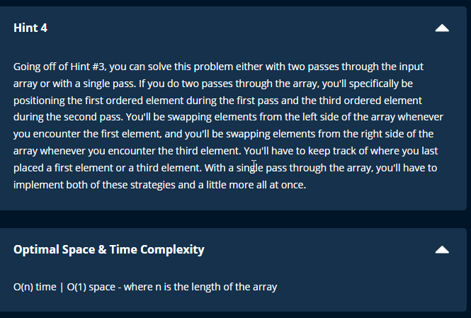

Slide 6
Steps
Initialize a list counts with three zeros to represent the count of each element in the order array.
Loop through the array and for each number, find its index in the order array and increment the count for that index in the counts array.
Loop through the three elements in order and for each element, loop through its count in the counts array and set the i-th element in array to the j-th element in order.
Return the sorted array.

Slide 7
Space and time complexity
Time = O(n)
N = length of the input array
2 times = one to calculate the count and one to sort
Space = O(1) (sort within the array)

